Slide 1

INTRODUCTION TO GENAI AND PYTHON REVISION

Slide 2


What is Genai?
Generative AI (GenAI) refers to artificial intelligence systems that can create new content, such as text, images, music, video, or even code, rather than just analyzing existing data.
ChatGPT : generates text
DALL·E : generates images

Slide 3
LLMs
They are a type of GenAI trained on massive amounts of text data (internet, books, articles, code, etc.).
They learn language structure, reasoning, and world knowledge.
Large = billions of parameteres

Slide 4
TIMELINE
“Can Machines Think?”
He also proposed the Turing Test, a way to check if a machine can act “intelligently” like a human.
This marked the birth of Artificial Intelligence as a concept.
1943 — MP Neuron
The first mathematical model of a neuron, inspired by the human brain.
It showed how machines could simulate simple decision-making, the starting point of neural networks.
1951 — Artificial Neural Network
The first working neural network was built, a machine that could learn from data.
It laid the foundation for what we now call Machine Learning (ML).
Back propogation

Slide 5
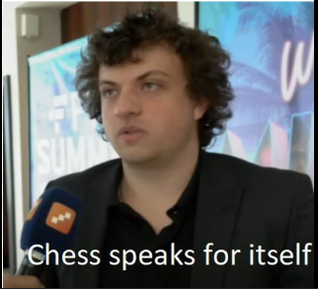
TIMELINE
1986 — Deep Learning Begins
The idea of “backpropagation” was introduced, allowing neural networks to learn from their mistakes.
This was the start of Deep Learning, where computers began recognizing images, speech, and patterns more accurately.
2017 Onwards — The Generative AI Era
The Transformer architecture was introduced (“Attention is All You Need”).
This changed everything leading to GPT, ChatGPT, Claude, Gemini, and more.
Old Stockfish = Pure logic-based AI
New Stockfish (with NNUE) = Logic + Deep Learning

Slide 6
ai buzz words
AI
ML - Machine learning
Deep learning
Generative AI
LLMS - Large language models

Slide 7
Python revision

Slide 8
Transformers
literally the core architecture that made LLMs possible
Transformers are the architecture behind all modern LLMs
They gave AI the ability to:
Understand context
Generate coherent text
Remember long conversations
Without Transformers, there’s no ChatGPT, no copilots, no autonomous agents.

Slide 9
what existed before transformers?
Before Transformers, language models had memory problems.
Old NLP → rule-based
RNNs & LSTMs could handle short text but:
Forgot long-term context
Processed text word by word (slow!)
Couldn’t scale to big data or complex relationships
2017 → Google drops “Attention Is All You Need”.
Long Short-Term Memory
Recurrent neural network

Slide 10
the Core Idea
Each word can look at every other word in a sentence
The model assigns attention weights: which words are important?
e.g., in “The dog chased the ball because it was fast” →
it attends more to dog than ball
This gives the model:
True contextual understanding
The ability to connect ideas far apart
Better reasoning & coherence

Slide 11
THANK YOU

